Slide 1
Mobile Plaforms and Cyberwarfare: Diversity is Good Fragility is Bad Misplacement is Ugly
Ronald P. Loui, Ph.D. Assistant Professor of Computer Science University of Illinois Springfield

Slide 2
Mobile Plaforms and Cyberwarfare: Diversity is Good; Fragility is Bad; Misplacement is Ugly This presentation argues that ‘survivability based on diversity’ is the best strategy for an open society that depends on a dynamic use of information technology. The good news for mobile IT is that there is a healthy ecosystem of various vendors, operating systems, and carriers. Mobile platform heterogeneity appeared to exceed the author’s guidance for a minimum of 70-20-10 mix throughout the hardware and software layers.

Slide 3
Mobile Plaforms and Cyberwarfare: Diversity is Good; Fragility is Bad; Misplacement is Ugly The bad news with respect to mobile computing trends and cyberwarfare can be observed in Iraq and Afghanistan today. Our troops are not allowed to use them. They are too easy to corrupt, too easy to packet sniff, too easy to disinform. That's bad when mobile platforms are carrying a lot of the apps that people are used to relying on.

Slide 4
Mobile Plaforms and Cyberwarfare: Diversity is Good; Fragility is Bad; Misplacement is Ugly There is a silver lining to the ugliness of mobile compuing fragility and our over-reliance on it. Cyberwar is about offense too. If we are prudent in the way that we mix our mobile and hard-wired systems, if we cloud and tether judiciously, so that the allocaion of funcion to device matches naional interest, not just market potenial, then the onus will be on our future adversaries to be as clever and thoughful as we can be today.

Slide 5
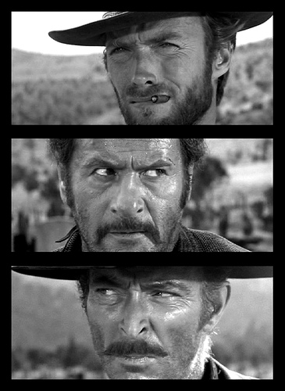
Diversity/Diversification
Misplacement
Fragility

Slide 6
Diversity/Diversification
How To Survive An Electronic Pearl Harbor

Slide 7
How To Survive an Electronic Pearl Harbor
In cyberwarfare, one of the most feared events is a surprise first strike with overwhelming force or debilitating result
Often called cyber-9/11 or cyber-Pearl-Harbor
The fear: Zero-day exploits, constantly changing technologies, sudden vulnerabilities, unknown asymmetric threats
“Unknown Unknowns”
If you thought Admiral Yamamoto was “sneaky,”
consider all the kids in Iran and North Korea reading Sun Tzu’s Art of War and Hacking for Dummies
And all the kids in China

Slide 8
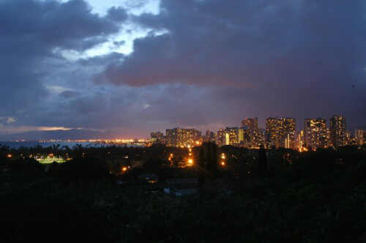
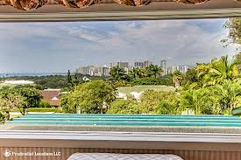
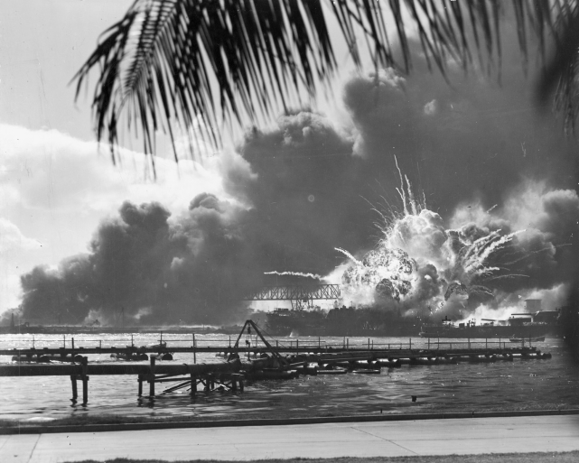
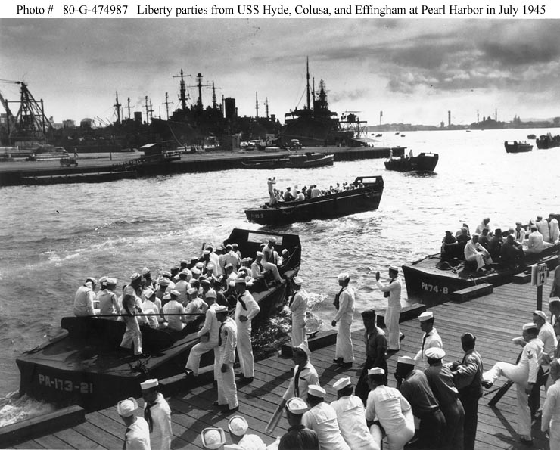
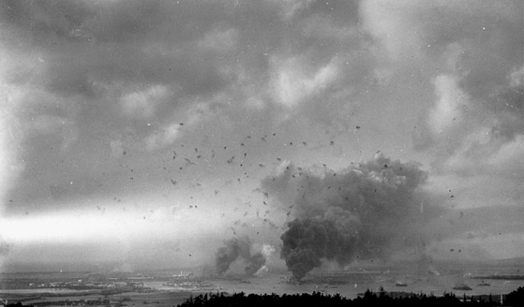
How To Survive an Electronic Pearl Harbor
Good News: We actually survived Pearl Harbor
I really mean “we” (view from my family’s house)

Slide 9
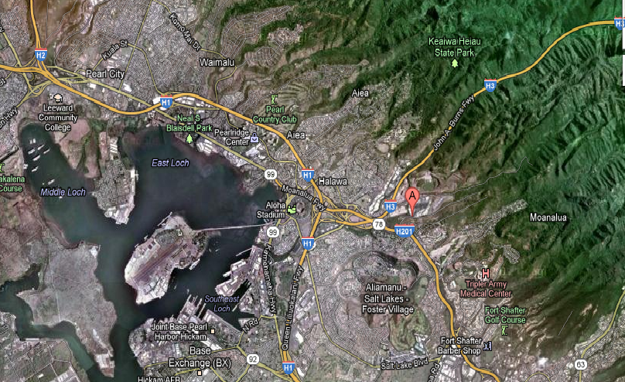
How To Survive an Electronic Pearl Harbor
Maybe the obsolescent battleships did not fare well
But the carriers were out to sea
A potential third wave of IJN attack did not destroy fuel reserves
250M gallons at Red Hill
What Japan really needed to destroy
USAAF air-to-air scores that day were 9-0 vs. Vals & Zekes and at least 8-1 vs. Zeroes
The one air-to-air loss, Gordon Sterling, Jr.
was not even a fighter pilot
and he scored before being KIA BNR
VALS/ZEKES: KT, KT/GW, KT, KT (uncredited), GW, GW, GW (returned to CV), JD, HB/BR
ZEROES:HB/MMx2, GS, LS/PR/JT x 5 http://www.pearlharborattacked.com/cgi-bin/IKONBOARDNEW312a/ikonboard.cgi?act=Print;f=14;t=44
The real key to US Power in the Pacific

Slide 10
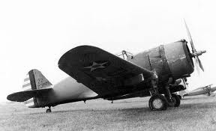
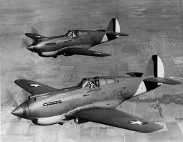
How To Survive an Electronic Pearl Harbor
USAAF air-to-air scores that day were 17-1
Welch and Taylor were up within 1hr, carried the load for 2hrs
Gabreski was in the air by hr 3, and had no kills, but would later earn 13 DFC’s
P-36 was outdated, but could out-maneuver long range Zeroes low on fuel
P-40 was less maneuverable but could dive quickly upon torpedo bombers
Both plane designs were needed that day
Many other plane types proved useless, including Boeing P26, Douglas B18 and A20, Grumman F4F, Vought SB2U http://www.ww2pacific.com/aaf41.html

Slide 11
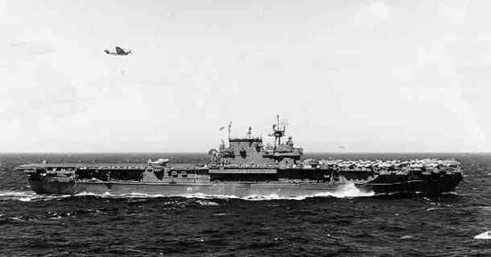
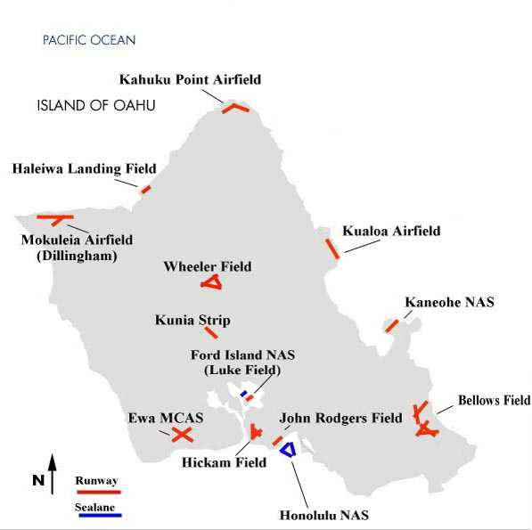
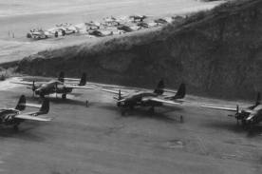
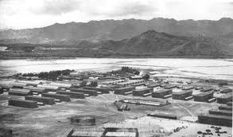
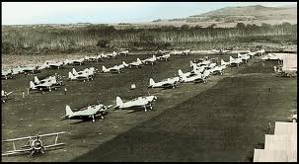
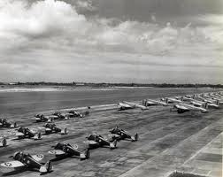
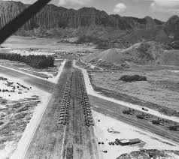
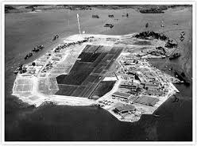
How To Survive an Electronic Pearl Harbor
USN, USMC, and USAAF had many airfields on Dec 7, 1941

Slide 12
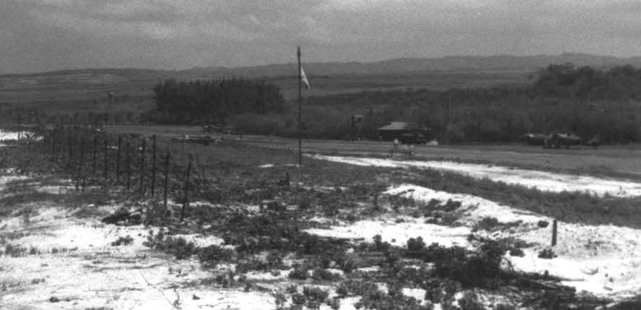
How To Survive an Electronic Pearl Harbor
The IJN forgot to attack Haleiwa Emergency Landing Strip
It was too small to bother with

Slide 13
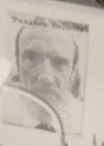
How To Survive an Electronic Pearl Harbor
With 5% of its pursuit fighters in the air
Within 1-2 hours of initial attack
With out-of-date planes
With P36 pilots in P40s and vice versa
Achieved air superiority
Deterred a third strike
Won air-to-air combat overwhelmingly
Protected against invasion
Might have located IJN attack carriers
Shout out to Mr. Lawrence, 3rd wing in the air, who taught us BASIC on an HP1000/RTE at Punahou School

Slide 14
How To Survive an Electronic Pearl Harbor
My New RULE:
As true in biology as it is in portfolio management
Notice that locking down the air fields did not work
Multiple useable channels, not perfectly secured channels
At least a 70-20-10 mix
Survival Through Diversity

Slide 15
How To Survive an Electronic Pearl Harbor
At least:
E=.80 entropy target
90-10 is just E=.325
70-10-10-10 is E=.94
33-33-33 is E=1.10
60-10-10-10-10 is E=1.23
Basic engineering: with a 90% chance of successful attack against each independent channel
2-channel system survives 19% of the time
3-channel system survives 27% of the time
4-channel system survives 34% of the time
5-channel system survives 41% of the time
70 – 20 – 10 mix

Slide 16
How To Survive an Electronic Pearl Harbor
At least:
At all technology layers
Hardware, software, vendor, and paradigm
For example, 70% Apache servers, 20% IIS, 10% nginx (actual 65-16-8 market shares in 2011, E=.75) http://royal.pingdom.com/2011/09/16/microsoft-iis-web-server-market-share-loss/
For example, Desktop PC OS’s, 70% Microsoft, 20% Linux, 10% MacOS (actual 92-6-1 market shares in 2009, E=.61) http://www.linuxfordevices.com/c/a/News/Linux-Foundation-enterprise-Linux-survey-plus-Net-Applications-desktop-stats/
70 – 20 – 10 mix

Slide 17
How To Survive an Electronic Pearl Harbor
At least:
“Doesn’t that increase surface area for attack?”
I am happy if you divert resources to attack Haleiwa
(One more worry for you)
(Knocking down one channel should not imply access to another)
Doesn’t that require 3x more patching?
Haleiwa was a dirt and grass field with no recent upgrades
(Emergency services serve only a small fraction of the load, and for short durations)
Isn’t that 3x the personnel, space, and expense?
Haleiwa was cheap to build, cheap to operate, and did not dilute forces
(Resources are not the same things as commitments)
70 – 20 – 10 mix

Slide 18
How To Survive an Electronic Pearl Harbor
At least:
“Doesn’t that increase surface area for attack?”
I am happy if you divert resources to attack Haleiwa
(One more worry for you)
(Knocking down one channel should not imply access to another)
Doesn’t that require 3x more patching?
Haleiwa was a dirt and grass field with no recent upgrades
(Emergency services serve only a small fraction of the load, and for short durations)
Isn’t that 3x the personnel, space, and expense?
Haleiwa was cheap to build, cheap to operate, and did not dilute forces
(Resources are not the same things as commitments)
70 – 20 – 10 mix

Slide 19
How To Survive an Electronic Pearl Harbor
At least:
“Doesn’t that increase surface area for attack?”
I am happy if you divert resources to attack Haleiwa
(One more worry for you)
(Knocking down one channel should not imply access to another)
Doesn’t that require 3x more patching?
Haleiwa was a dirt and grass field with no recent upgrades
(Emergency services serve only a small fraction of the load, and for short durations)
Isn’t that 3x the personnel, space, and expense?
Haleiwa was cheap to build, cheap to operate, and did not dilute forces
(Resources are not the same things as commitments)
70 – 20 – 10 mix

Slide 20
How To Survive an Electronic Pearl Harbor
At least:
Rethink Technology Management/Procurement/Deployment:
Avoid the desire to be pure
Avoid the desire to be trendy
Avoid the desire to banish the tried-and-true
Avoid the desire to be a “Brand X Shop” or “Company X Partner”
Understand that variation leads to improved best practices
Understand that competition among vendors is good
Understand that internal competition can be good
Understand that robustness is opportunity, not inefficiency
Reduce the overhead of authorization/approval
70 – 20 – 10 mix

Slide 21
How To Survive an Electronic Pearl Harbor
At least:
Rethink Technology Management/Procurement/Deployment:
Avoid the desire to be pure
Avoid the desire to be trendy
Avoid the desire to banish the tried-and-true
Avoid the desire to be a “Brand X Shop” or “Company X Partner”
Understand that variation leads to improved best practices
Understand that competition among vendors is good
Understand that internal competition can be good
Understand that robustness is opportunity, not inefficiency
Reduce the overhead of authorization/approval
70 – 20 – 10 mix

Slide 22
How To Survive an Electronic Pearl Harbor
At least:
Rethink Technology Management/Procurement/Deployment:
Avoid the desire to be pure
Avoid the desire to be trendy
Avoid the desire to banish the tried-and-true
Avoid the desire to be a “Brand X Shop” or “Company X Partner”
Understand that variation leads to improved best practices
Understand that competition among vendors is good
Understand that internal competition can be good
Understand that robustness is opportunity, not inefficiency
Reduce the overhead of authorization/approval
70 – 20 – 10 mix

Slide 23
How To Survive an Electronic Pearl Harbor
At least:
If we were to audit your IT mix
I am sure you would be at least as diverse as the USAAF on Dec 7, 1941
I am sure you would not think lock-down is sufficient defense
I am sure you would not want to be the next Admiral Kimmel
As he watched the disaster across the harbor unfold with terrible fury, a spent bullet crashed through the glass. It brushed the admiral before it clanged to the floor. It cut his white jacket and raised a welt on his chest. "It would have been merciful had it killed me.”
70 – 20 – 10 mix

Slide 24
Mobile Ecosystem
The Free Market is Working

Slide 25

The GOOD: Mobile Ecosystem Diversity
So how well is the world of mobile computing doing w.r.t. a ???
There is a natural diversity
because many firms have wanted to be in this space
without any one being able to dominate for long
Mobility is itself a variation of computing
adding platform options to a world of fixed devices:
desktop PCs, servers, firewalls, industrial controllers, clouds, …
70 – 20 – 10 mix

Slide 26
The GOOD: Mobile Ecosystem Diversity
http://electronics.wesrch.com/page-summary-pdf-EL1AB98LWHHVA-tablet-vs-pcs-vs-netbooks-vs-smartphones-market-share-and-forecast-8
Mobile Platforms 2013 Market Share (New Sales, not Installed Base)
Tablets 33%
Smart Phones 29%
PCs 18%
Notebooks 11%
Netbooks 8%
E = 1.478

Slide 27
The GOOD: Mobile Ecosystem Diversity
http://bgr.com/2013/01/25/smartphone-market-share-q4-2012-306399/
SmartPhone Vendor Q42012 Market Share (New Sales, not Installed Base)
Samsung 29%
Apple 22%
Huawei 5%
Sony 4.5%
ZTE 4.3%
Others 35.5%
E = 1.484

Slide 28
The GOOD: Mobile Ecosystem Diversity
http://venturebeat.com/2013/01/28/android-captured-almost-70-global-smartphone-market-share-in-2012-apple-just-under-20/
SmartPhone OS 2012 Market Share (New Sales, not Installed Base)
Android 68.4%
iOS 19.4%
Other 12.2%
E = .835
(This 70-20-10 is not ideal, but it is minimally acceptable)

Slide 29
The GOOD: Mobile Ecosystem Diversity
http://www.rcrwireless.com/article/20101102/networks/top-10-tower-companies/
Major Tower Companies 2010 Market Share
Crown 28%
American 26%
AT&T 14%
SBA 11%
T-Mobile 9%
Global 5%
Mobilitie 4%
TowerCo 4%
E = 1.849
But all the same technology?

Slide 30
The GOOD: Mobile Ecosystem Diversity
Various sources
Mobile Processor 2012 Market Share (New Sales, not Installed Base)
For notebooks: Intel 80%
For smart phones: ARM: 90%
For embedded processors: ARM 68%, Intel 5%
Perhaps not as good!
The aggregate would mask the defacto monopolies

Slide 31
The GOOD: Mobile Ecosystem Diversity
http://thenextweb.com/apps/2013/02/01/ie-breaks-55-market-share-as-three-month-old-ie10-passes-1-chrome-is-only-browser-to-decline/
Browser Use Worldwide 2013 Market Share
IE 55%
FF 20%
Chrome 17.5%
Safari 5%
Opera 2%
E = 1.184

Slide 32
The GOOD: Mobile Ecosystem Diversity
We must be vigilant to make sure that apparently good diversity is not the result of aggregation over multiple monopolies
For example, it would be bad if
all nuclear power station engineers used the same version of Linux, and
all electrical grid network engineers used Apple MacOS
and it just looked like a 50-50 balance after aggregation

Slide 33
The GOOD: Mobile Ecosystem Diversity
Is it our job to diversify?
Political Economy 101
Shape the market so it produces socially desirable results
Don’t let national security costs become an externality
“too-big-to-fail” market share:
subsidize alternative vendors and alternative architectures
You cannot insure against the costs of military failure after the fact –
Electronic Pearl Harbor liability is not the same as Gulf Oil Spill liability

Slide 34
Mobile Fragility
How To Be a Casualty of Cyberwarfare

Slide 35

The BAD: Mobile Fragility
As a platform for C3 in Cyberwarfare, Mobile:
Often communicating over public air waves
intercepted, blocked, faked/spoofed, hacked
unavailable
Often misconfigured for its environment
Open Wireless, Bluetooth, permissive
Often short battery life
Devices become no longer functional
Often insufficient performance for emergency situations
Insufficient display
Insufficient input bandwidth
Insufficient processor, memory, bandwidth
Reduced functionality versions of software

Slide 36
The BAD: Mobile Fragility
As a platform for C3 in Cyberwarfare, Mobile:
Often beyond the reach of sysadmins and security professionals
Often not monitored for intrusion, data loss, or anomaly during use
Often being used for one function, which precludes their use for another
Often mix personal and professional activity
Often furnish convenient software, not secure software
often exposed to hostile communications
Often easily damaged physically
Often forgotten or misplaced
Often fatiguing for long sessions

Slide 37
The BAD: Mobile Fragility
As a platform for C3 in Cyberwarfare:
For all these reasons and more
It is a mistake to migrate critical command and control to mobile devices except as a well-secured backup channel

Slide 38
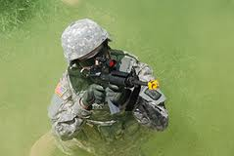
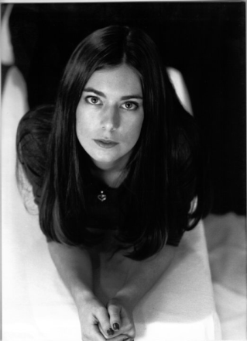
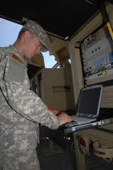
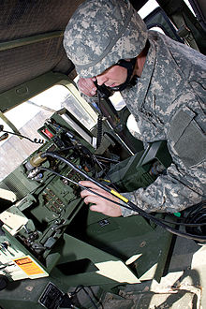

The BAD: Mobile Fragility
What’s Worse:
A generation of citizens uses its personal mobile devices for basic daily functioning:
As a watch/stopwatch/alarm/calendar/light
As a memory crutch/camera/notepad
As a map/interpreter of space
As a reference for factual information
As a friend
US Army Sergeant:
“We aren’t allowed to use any US mobile devices off base”
“We would have to buy local devices and pay to use international lines”
“We memorize what we need, and we have things called watches, compasses, and maps, SINCGARS, ruggedized laptops in Humvees“
“We shoot mobile devices if we have to leave them”

Slide 39
The BAD: Mobile Fragility
What’s Worse:
US Army Sergeant:
“We aren’t allowed to use any US mobile devices off base”
“We would have to buy local devices, or pay a lot to use international lines”
“We memorize what we need, and we have things called watches, compasses, and maps, SINCGARS, ruggedized laptops in Humvees”
“We shoot mobile devices if we have to leave them”
Problem?
At the very least, a training problem
Extinguish civilian habits
Maintain a separate IT culture (not as well developed or tested)
Must provide non-civilian backup channels

Slide 40
The BAD: Mobile Fragility
What’s Worse:
US Army Sergeant:
“We aren’t allowed to use any US mobile devices off base”
“We would have to buy local devices, or pay a lot to use international lines”
“We memorize what we need, and we have things called watches, compasses, and maps, SINCGARS, ruggedized laptops in Humvees”
“We shoot mobile devices if we have to leave them”
Problem?
Of course, well-secured, military-grade mobile IT for C3 is impressive
If you maintain uninterrupted GPS
Don’t suffer DOS attacks
Are generally immune to EW
Have no insider IT threats

Slide 41

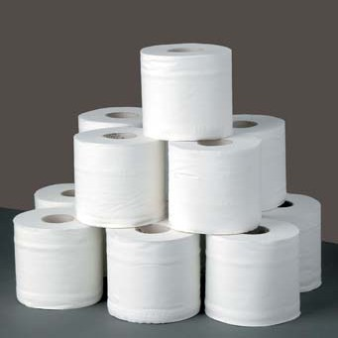
The BAD: Mobile Fragility
What’s Worse:
US Army Sergeant:
“We aren’t allowed to use any US mobile devices off base”
“We would have to buy local devices, or pay a lot to use international lines”
“We memorize what we need, and we have things called watches, compasses, and maps, SINCGARS, ruggedized laptops in Humvees”
“We shoot mobile devices if we have to leave them”
Problem?
Mobile is off-grid C3
Mobile has diverse power possibilities
Problem is Theoretical:
Soldiers more likely to complain about missing toilet paper than missing angry birds

Slide 42
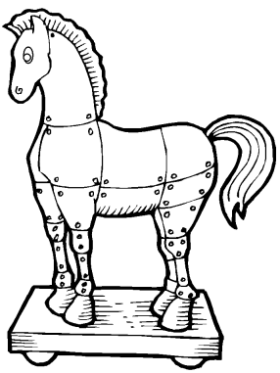
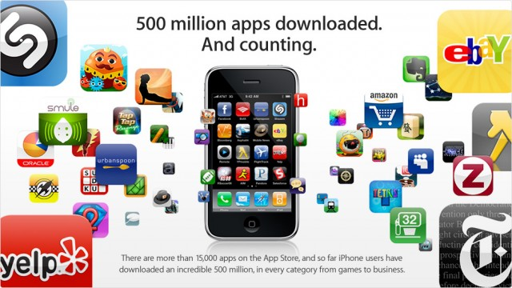
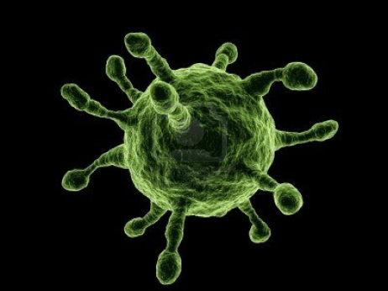


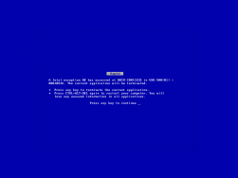


The BAD: Mobile Fragility
What’s Worse:
Mobile Apps are Just Trojan Horses, Viruses, and Crashes waiting to happen

Slide 43
The BAD: Mobile Fragility
Why are Mobile Apps So Popular?
Off-line programming
Reduced server loads
Cross-platform presentation
Programmable camera, GPS
User-tracking
Users pay for them
Users like them
Logos, not URLs

Slide 44
The BAD: Mobile Fragility
Why are Mobile Apps So Popular?
Marketing people like them and they are trendy
Marketing people like them and they are trendy
Marketing people like them and they are trendy
Marketing people like them and they are trendy
Marketing people like them and they are trendy
Marketing people like them and they are trendy
Marketing people like them and they are trendy
Marketing people like them and they are trendy

Slide 45
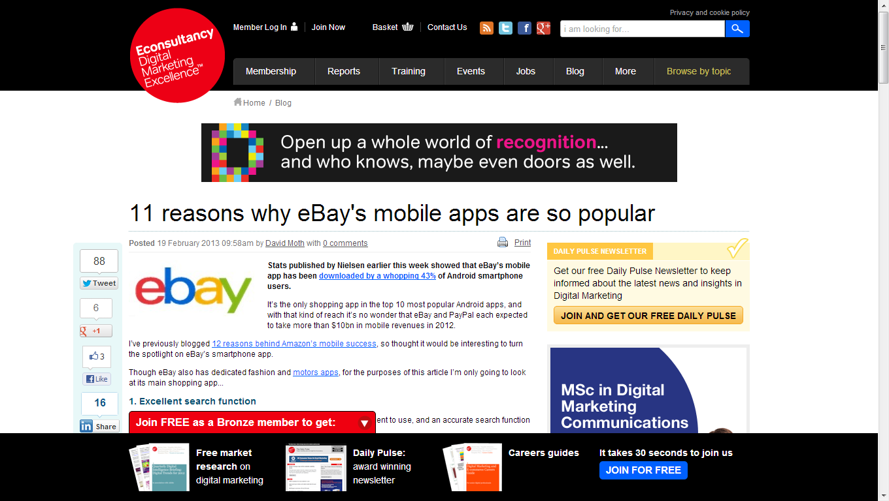
The BAD: Mobile Fragility
Why are Mobile Apps So Popular?

Slide 46
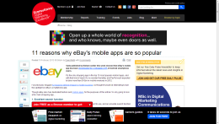
The BAD: Mobile Fragility
Why are Mobile Apps So Popular?
Excellent Search Function
Just like the main web site
Sorting by Best Match/Lowest/Highest Price
Just like the main web site
Paypal
Just like the main web site
Big calls-to-action
Also known as big buttons
Barcode scanner

Slide 47
The BAD: Mobile Fragility
Ubiquitous Access DOES NOT EQUAL Ubiquitous Ability:
A Recent Set of Disappointments
Drove to Cleveland via Chicago with smartphone and netbook
Left the wireless-only iPad
Would have two 3G iPads in Chicago
Could read student .docx but not mark it up
McDonald’s wireless down
In-laws’ wireless locked up
iPad browser would not work with online course site bb.uis.edu
iPad browser filled out forms poorly
Verizon limited bandwidth on streaming data
I had a 12v USB charger!

Slide 48
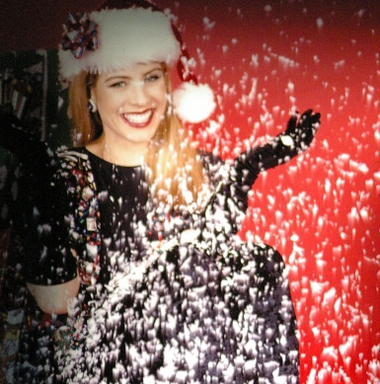
The BAD: Mobile Fragility
Ubiquitous Access DOES NOT EQUAL Ubiquitous Correctness:
A Really Embarrassing AJAX/FB Fail
Facebook Messaging
Ajax processes an incoming message while I am composing “too-friendly” message
Javascript changes local storage of return addresses
Facebook sends message to wrong person
To: High school classmate, former Miss Hawaii/Miss USA 4th-RunnerUp
I immediately send email apologizing
Facebook sends apology to wrong person
This is not even malware or hack
Just life on a smartphone
When it is not ghost dialing or rebooting or making me use bing
Not the platform for mobile C3 in .mil, .gov, or .com

Slide 49
Mobile Misplcement
How To Win a Cyberbattle

Slide 50

The UGLY: Mobile Misplacement
Once upon a time, the CEO I was consulting with lost his iPhone
End of Story

Slide 51
The UGLY: Mobile Misplacement
Misplacement is not just physical loss of device
Misplacement of unsecured wireless access points
Misplacement of data & programming
Misplacement of authority
Misplacement of controls
Convenience is not sufficient reason to move C3 functions to mobile devices

Slide 52
The UGLY: Mobile Misplacement
For example, I would not do (nor depend on)
Regional electrical grid control
From a device that can be lost, stolen, hacked, sniffed, spoofed, blocked, be out of range, or out of power
Convenience is not sufficient reason to move C3 functions to mobile devices

Slide 53
The UGLY: Mobile Misplacement
But cyberwar is about offense, too
You want your adversaries to have exploits
You want an IT ecosystem that is not perfectly secured
Especially if it is to your advantage
We should place our resources well
Overseas over-reliance on mobile tech, or under-use, is their problem
Lots of potential adversaries depend on mobile IT, lacking fixed networks
Lots of potential adversaries cannot diversify as well

Slide 54
The GOOD: Mobile Misplacement
But cyberwar is about offense, too
You want your adversaries to have exploits
You want an IT ecosystem that is not perfectly secured
Especially if it is to your advantage
We should place our resources well
Overseas over-reliance on mobile, or under-use, is their problem
Lots of potential adversaries depend on mobile IT, lacking fixed networks
Lots of potential adversaries cannot diversify as well
I DO NOT advocate mobile security; let it be UGLY
I ASK, what can you do to manage your critical mobile C3 in a GOOD way?

Slide 55
The GOOD: Mobile Misplacement
Combine GPS/biometrics with multi-layer authentication
Don’t just grant access: Continuously monitor activity of remote users
Track your mobile devices
Keep your mobile devices clean and replace them often
Distribute responsibility for command, both for
independence/robustness and
corroboration/correctness
Say NO to Apps that are not your own

Slide 56
The GOOD: Mobile Misplacement
From Military Misfortunes: Anatomy of Failure in War (1990)
Chapter 9: What Can be Done?
“Each [misfortune] is the consequence of the inherent fragility of an entire organization. Misfortune lurks somewhere within the bowels of every military operation. It is ‘the ghost in the machine’ that can be conjured up by a variety of circumstances. … The chain of command is often more complex than the ‘wiring diagrams’ … and can operate in ways that are not immediately obvious … . A general or admiral … must be willing to entertain the possibility of large flaws in how his organization operates, and be willing to risk much to correct them.”
Good civilian cyberwarfare capability is about good IT management

Slide 57

Mobile Plaforms and Cyberwarfare: Diversity is Good, Fragility is Bad, Misplacement is Ugly
Ronald P. Loui, Ph.D. Assistant Professor of Computer Science University of Illinois Springfield
Comments?

